Slide 1

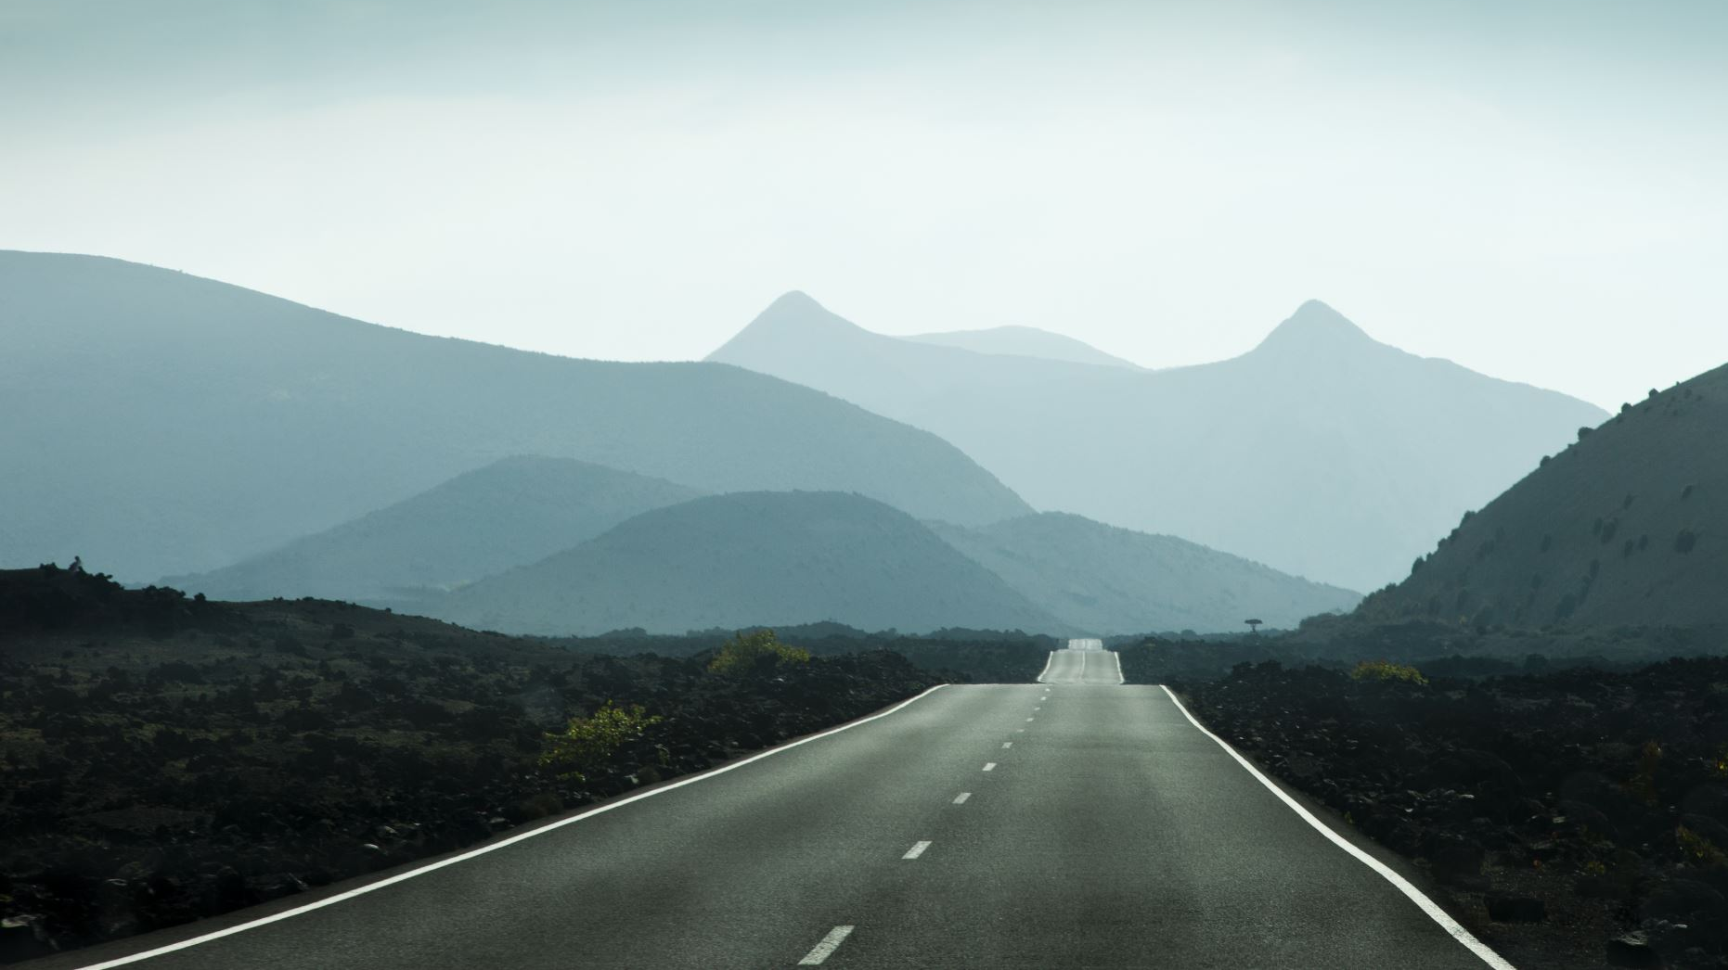
Smart India Hackathon
Day 2
EPOX

Slide 2
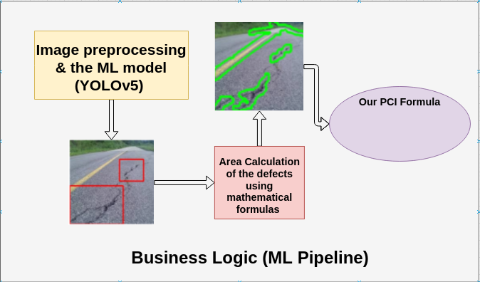

Slide 4
YOLO V5
Outperforms all the previous versions and competes with the mAP of Efficient Det with much higher FPS
State Of The Art
Comes in 4 variants - YOLOv5s,YOLOv5m,YOLOv5l and YOLOv5x
Inference time less that 500ms
Lowest inference time goes down to 7ms
This model compiles to a size of 27 MB which is well suited for mobile applications and our needs

Slide 5
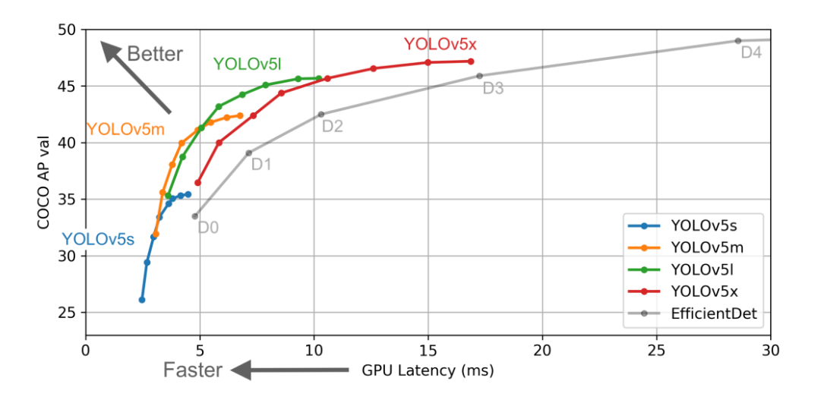
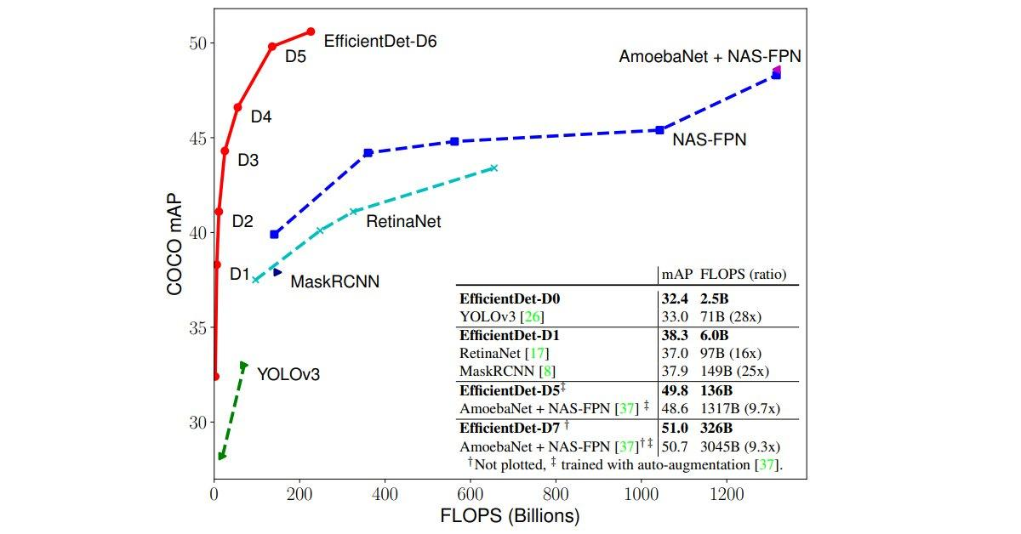

Slide 6
OUR MODEL ARCHITECTURE
165 layer deep neural network
Uses State of the Art Bi-FPN layers
Computes 6.86 million parameters
Our model has been trained for 16 hours on free resources (Google Colab )
Due to lack of computing power we couldn’t use large or x-large models
We made our own custom YOLO architecture between the small and medium model

Slide 7
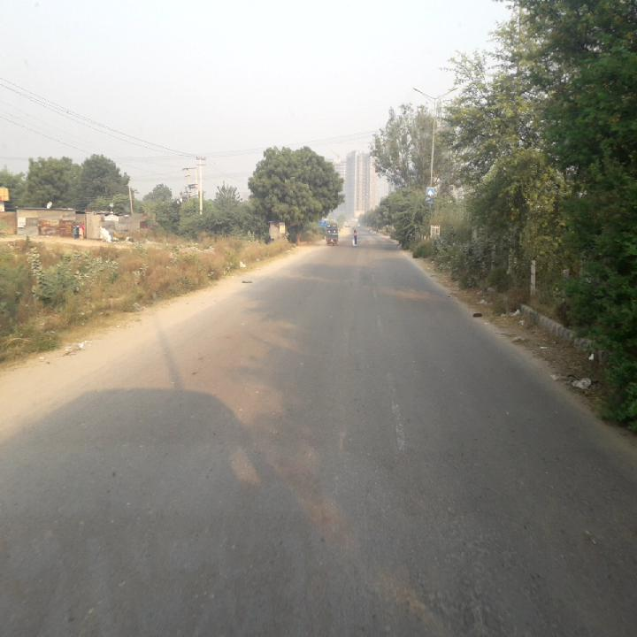
DATASET
Using dataset of Indian Roads (around Noida region)
We detect
  Linear Cracks - Longitudinal and Transverse Cracks
  Alligator Cracks
  Potholes
  Road Shoulders and furniture
Has ~7000 images, divided into train, validation and test

Slide 8
Popular Object-detection models
YOLO v5 : May 2020
YOLO v4 : April 2020
EFFICIENT DET : Nov 2019
DETECTRON 2 : 2019
YOLO v3 : March 2018
Faster RCNN : 2015
Fast RCNN : 2015
Uses the new
Bi-FPN Layer
Uses only CNN layers
Outdated

Slide 9
Questions we asked ourselves
Will YOLOv5 remain the State-of-the-art few years down the line ?
Is restricting our solution to a model really ensuring future proofing of the PCI formula ?

Slide 10
No!!!

Slide 11
So we needed to make our PCI calculation independent of the Computer vision model

Slide 12

Enter Model Error Coefficients
Uses the errors of the computer vision model to make corrections in the PCI formula
Make the PCI formula model Independent!!!

Slide 13






TECHNOLOGY STACK
Numpy
Scipi
CudaToolKit
Matplotlib
Pycocotools
Pillow
Tensorboard
YAML
Py-yaml

